Slide 1



L3: Blockchain “Fit-for-Purpose” Framework for Healthcare
Blockchain Applications for Healthcare
UCSD – Lipscomb Joint Specialized Certificate
Tim K. Mackey, PhD – UC San Diego
Associate Professor, Director

Slide 2
Reinforcing Blockchain Basics and separating out the hype

Slide 3
What is Blockchain?

Slide 4
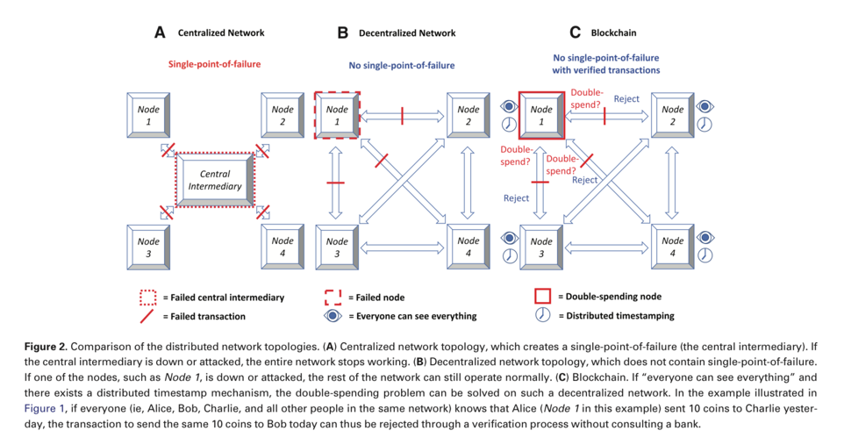
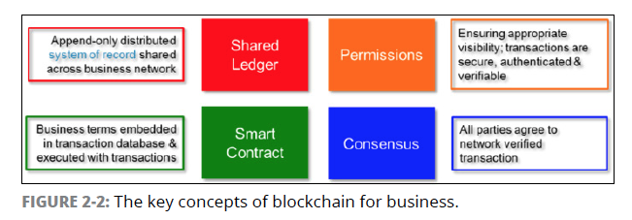
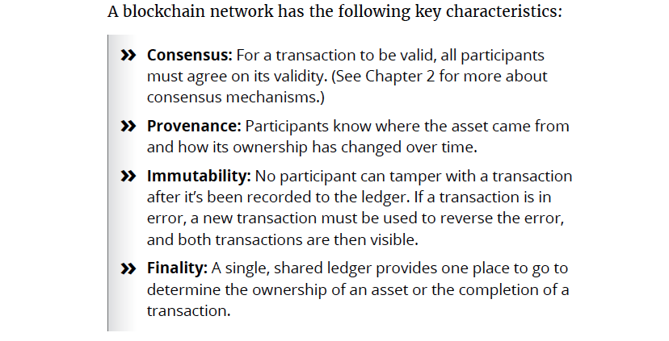
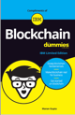
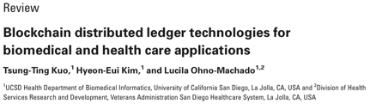
Blockchain Basics

Slide 5
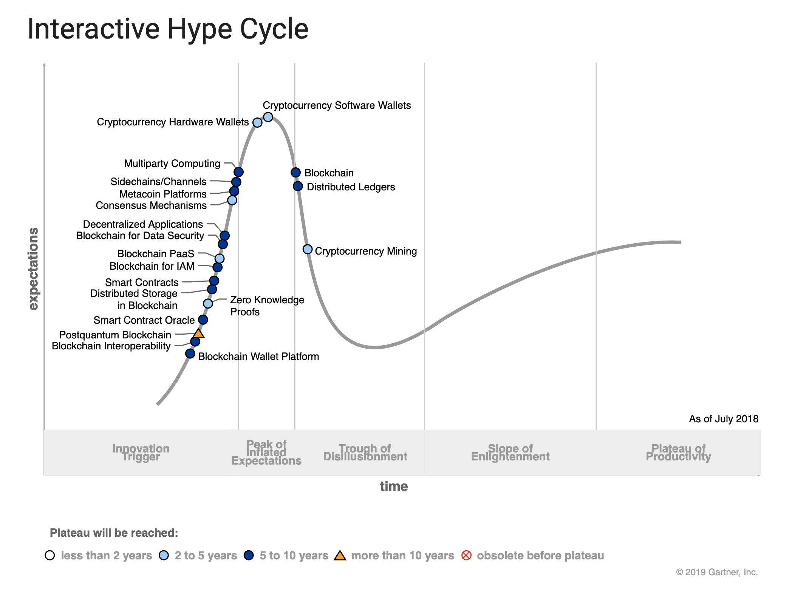
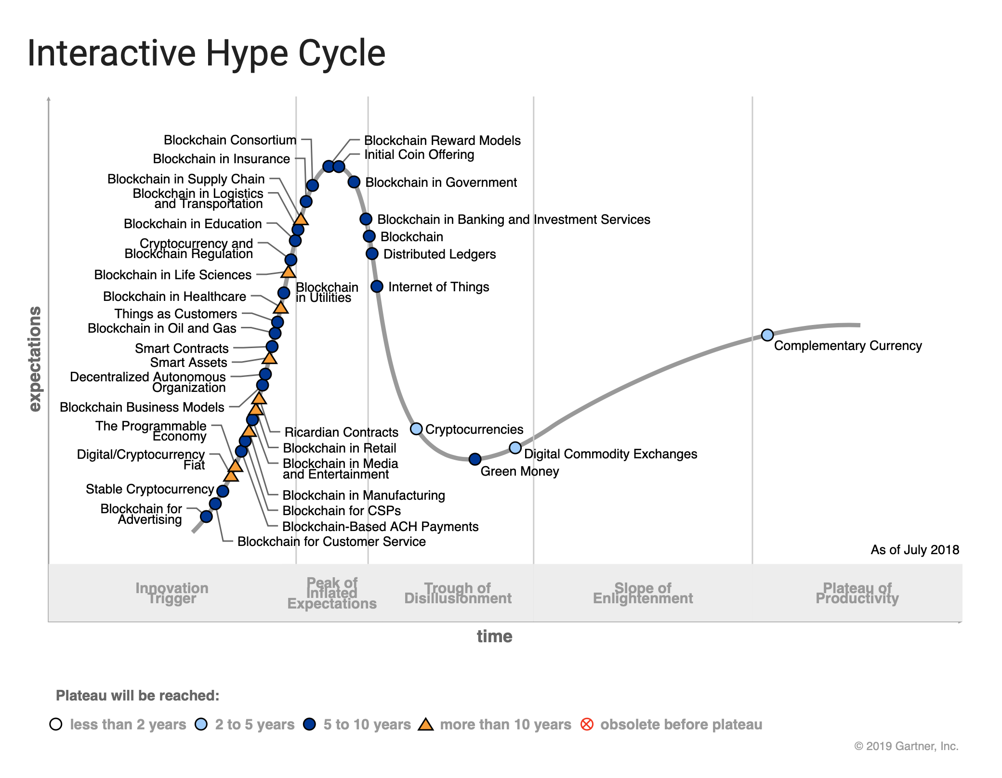


Slide 7
Blockchain Biomedical Research

Slide 8
The ”Fit-for-Purpose” Framework

Slide 9
Blockchain for Healthcare?
Core Principles and Design Element Considerations
Core Principles: At its core, a BC is an immutable distributed ledger that can better ensure the resilience, provenance, traceability, and management of healthcare data
Other characteristics for consideration
Data sharing, what is shared what is not? (levels of permissions)
Offchain storage vs. onchain storage
Governance of a BC, p2p networks, roles for regulators?
Use of smart contracts, and types of consensus mechanisms?
Design Decisions: Three primary design elements: (1) private models; (2) public models; and (3) hybrid (also consortium-based models.) These design choices should map to healthcare industry specific challenges and characteristics (→)
Beyond Blockchain: Beyond the design elements and core principles, what “added value” does a health blockchain have to offer? Examples include added compliance, audit, enabling aggregation/data sharing, incentivizing participation (tokens), etc.

Slide 10
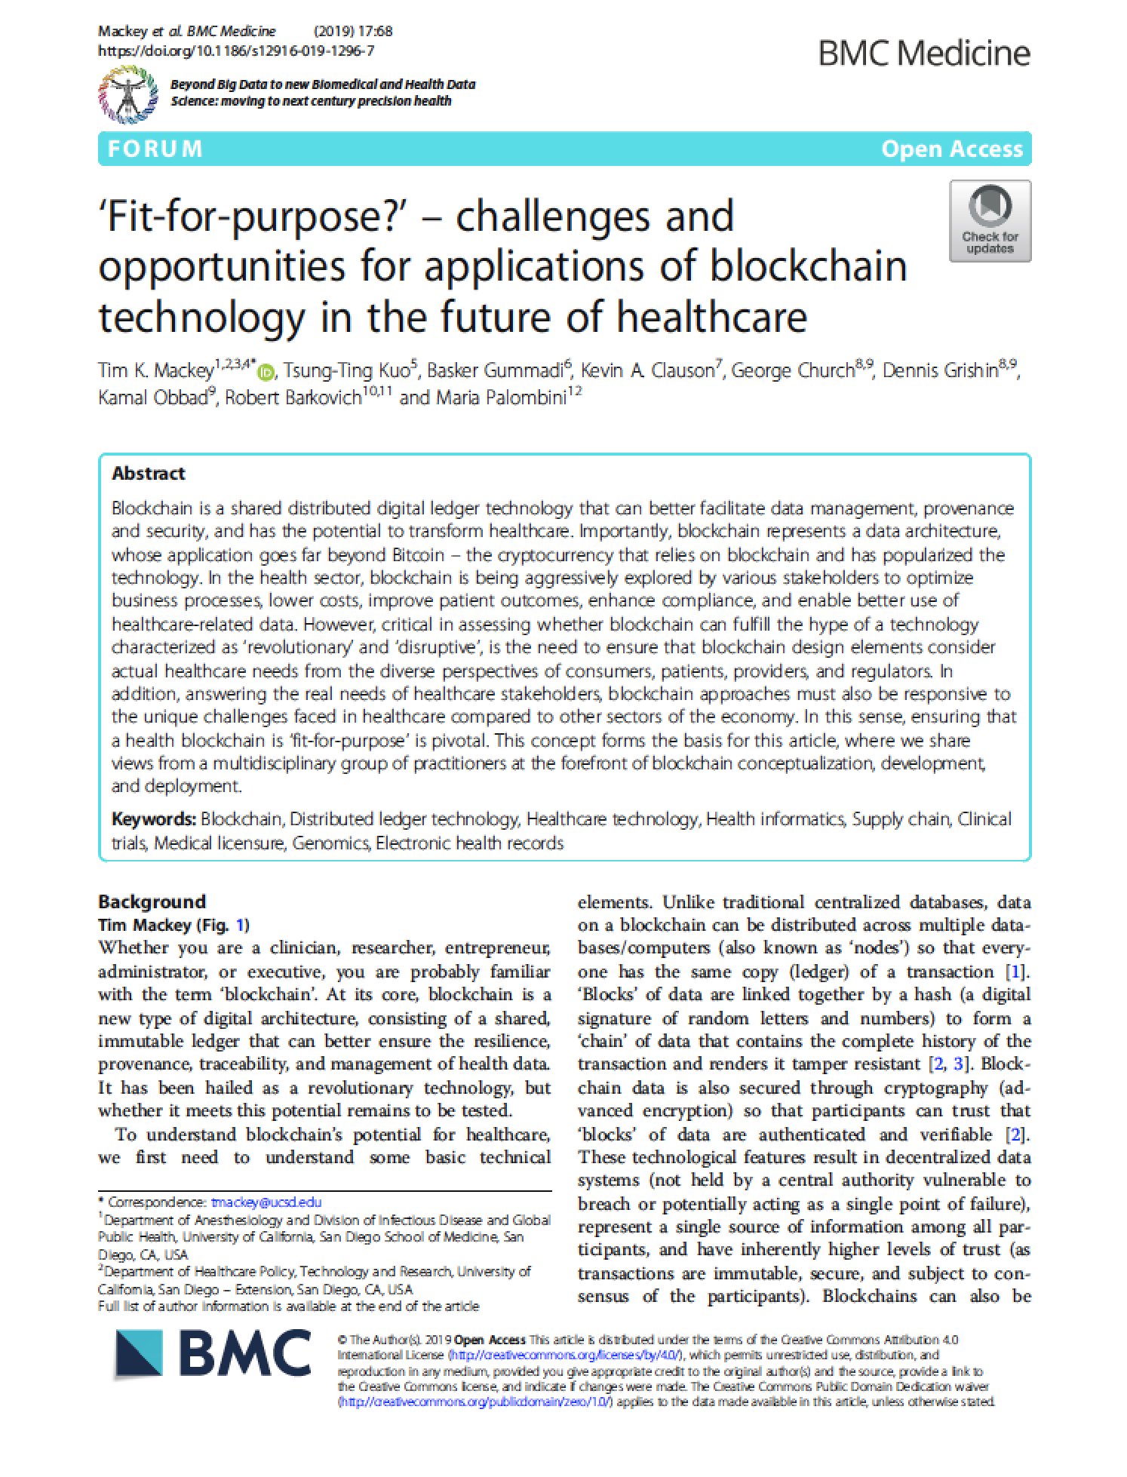





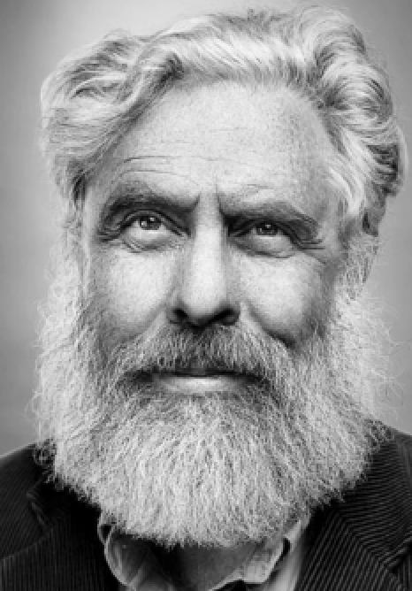
Fit-for-Purpose Model
Modular Blockchain Design
Article: Specific to healthcare use cases but can be applied to other industries and comparative analysis
Fit-for-Purpose Concept: Focuses on “modular” or “component” design for blockchain focusing on design types, data sharing and access, governance, technology layers, and ultimate goal of blockchain

Slide 11
Blockchain Architecture and Modularity

Slide 12

Design for “Health” Blockchain
Fit-for-purpose framework design elements
Who is your community and how will they govern the bc?
1. Design Type
Decide whether your blockchain will be a public (permission-less), private, or hybrid blockchain. These design characteristics should map to your healthcare challenge and your users and peers.
2. Data Sharing?
What levels of permission (if any) do you need for data that may be part of the blockchain. Will you store it off-chain, on-chain? What regulatory and legal considerations might lead you to assess data governance.
3. Governance
Who will be users and nodes of your blockchain? Do you want only select partners, consortium (a group of selected partners), regulators, and/or the public to be users, peers, and/or validators? Is this a patient-centric or process-centric bc?
X. Ultimate Goal
What is your ultimate goal for your blockchain solution, to improve a healthcare process, to enhance safety and quality, incentivize data sharing, drive revenue, ensure better compliance? Do you need a token to incentivize participation?
What data & design elements are needed to solve the challenge?

Slide 13
Mapping to Blockchain Healthcare Use Cases

Slide 14
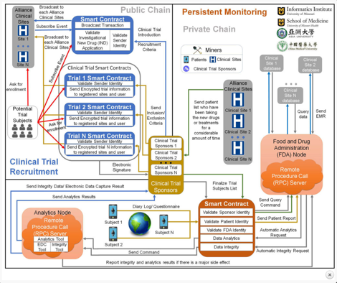

Clinical Trials
Problem: Clinical trials recruitment is expensive and time consuming. Study data should be verifiable and also follow study protocol and data sharing plan to support outcomes
Why Blockchain?: Can enable patient matching and monitoring (e.g. matching with EHRs), can validate data, can incentivize patient participation, enable e-consent
Design?: Clinical trial BC can adopt hybrid design with public (enrollment) and private (clinical trial protocol) components. Smart contracts can enable trial steps.
Additional meta-data in BC clinical trial attributes could help create shared patient databases for future participation and enable better sharing of trial results with subjects.

Slide 15
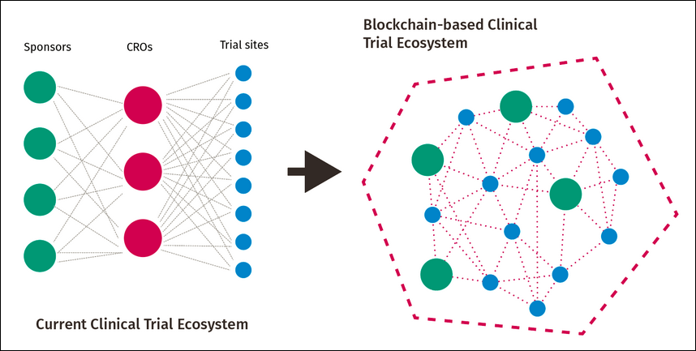
Architecture for Blockchain
Applications for Pharma (Gummadi)

Slide 16

Medical Device
Problem: Medical devices are becoming increasing enabled by wireless technology and reliant on health informatics for enhanced clinical decisionmaking. Security is key concern.
Why Blockchain?: Further enable devices beyond IoT to allow smart contracts for maintenance, can ensure tamper proof medical device logs, better validate insurance claims
Design?: Many models envision some interaction with patient/end use, so hybrid (public and private) might be the most common approach.
Meta-data collected from multiple medical devices in a BC could better enable complete digital health identify and better ensure continuity of care. Data could also better verify AEs and non-compliance

Slide 17
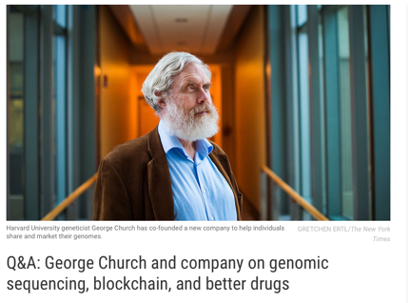
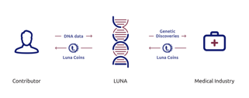
Genomics
Problem: The field of genomics and precision medicine is rapidly expanding along with the ability to generate large volumes of sequencing data (including DTC sequencing).
Why Blockchain?: Verification of disparate sources of genomic data w/out centralization that could enable greater sharing for research, drug dev, pop health analysis.
Design?: Several companies in the genomic BC space focus on public models that use tokens to encourage sharing of genomic data. Privacy and security key issues.
Genomic data in the blockchain could be one attribute of many. For example, PMI (“All of Us”), collects environmental, lifestyle, and biologic data that can be added to genomic data in a bc enviornment

Slide 18
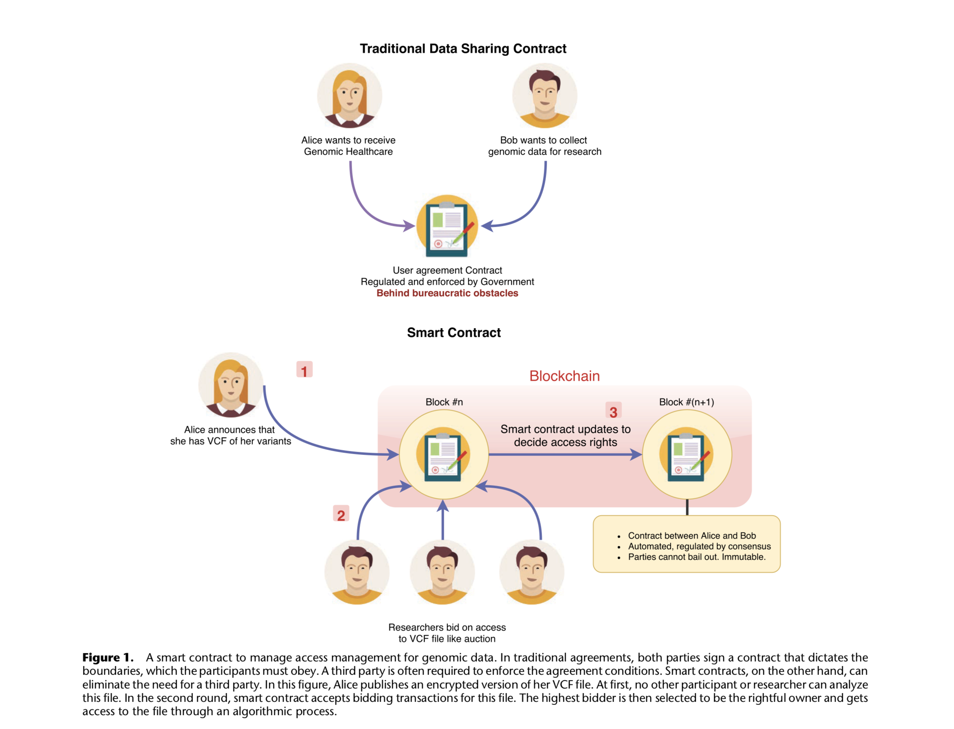

Ozercan et al.

Slide 19
Digital Health Identity
=
Patient Record
Genomic Data
Reimbursement Data
IoMT Data
Fitbit/Apple Watch
Consumer Health Data

Slide 20
Digital Health Identity

Slide 21
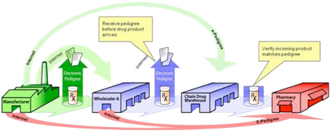
Drug Supply Chain
Healthcare Problem: The security of the drug supply chain has been compromised by infiltration of fake, falsified and substandard medicines. Complexity and lack of data sharing
Why Blockchain?: Enables provenance of supply chain data across multiple partners and better ensures integrity of the supply chain against fake medicine penetration
Design?: Given industry needs, a permissions-based blockchain that is private and extends to select trusted partners is being explored by several companies
Additional meta-data (e.g. e-pedigree) in BC on supply chain attributes could help identify risks of counterfeiting and can also be augmented with other verification technologies

Slide 22







Contract compliance based on identity
Validated as “honest” part of chain
Rejected
Private: Not open to public (consumers) or regulators, focused on manufacturer’s supplier networks. Compliance based on smart contracts
Manufacturer
Primary Wholesaler
Secondary Wholesaler

Slide 23





Contract compliance based on regulatory controls such as licensure (as required by DSCSA) and other standards
Validated as “honest” part of chain
Private and Regulator (Consortium): Not open to public (consumers) but limited visibility to regulators to monitor compliance of smart contracts.
Rejected
Manufacturer
Primary Wholesaler
Secondary Wholesaler

Slide 24




Validated as “honest” part of chain
Rejected
Hybrid/Public Blockchain: Added transparency to consumer level. Consumers can self-verify provenance and e-pedigree
Manufacturer
Primary Wholesaler
Secondary Wholesaler

Slide 25






Benefits of Pharma [Block]chain?
Key strengths of BC as a unifying solution
INTEGRATION
SECURITY
INTEROPERABILITY AND ANALYSIS
GLOBAL SOLUTION?
POLICY RATIONALE
Can be integrated into other anti-counterfeiting solutions and IoT: lab tests, holograms, QRC, RFID, e-pedigree solutions, NFC, scanning devices, mobile phones, smart contracts
Would enable a “shared” ledger of transparent, verified and secure public and private track and trace data from manufacturer → distributor → point of dispensing → patient
Could create publicly accessible data using open standards and allow for analysis in order to detect counterfeit drug infiltration, post alerts, and facilitate removal/recall
Could lead to standardization and regulatory harmonization across multiple countries/regulators via shared international data exchange
Policy instrument to support blockchain solutions as a already required under the DSCSA (added value and risk mitigation of technology)

Slide 26
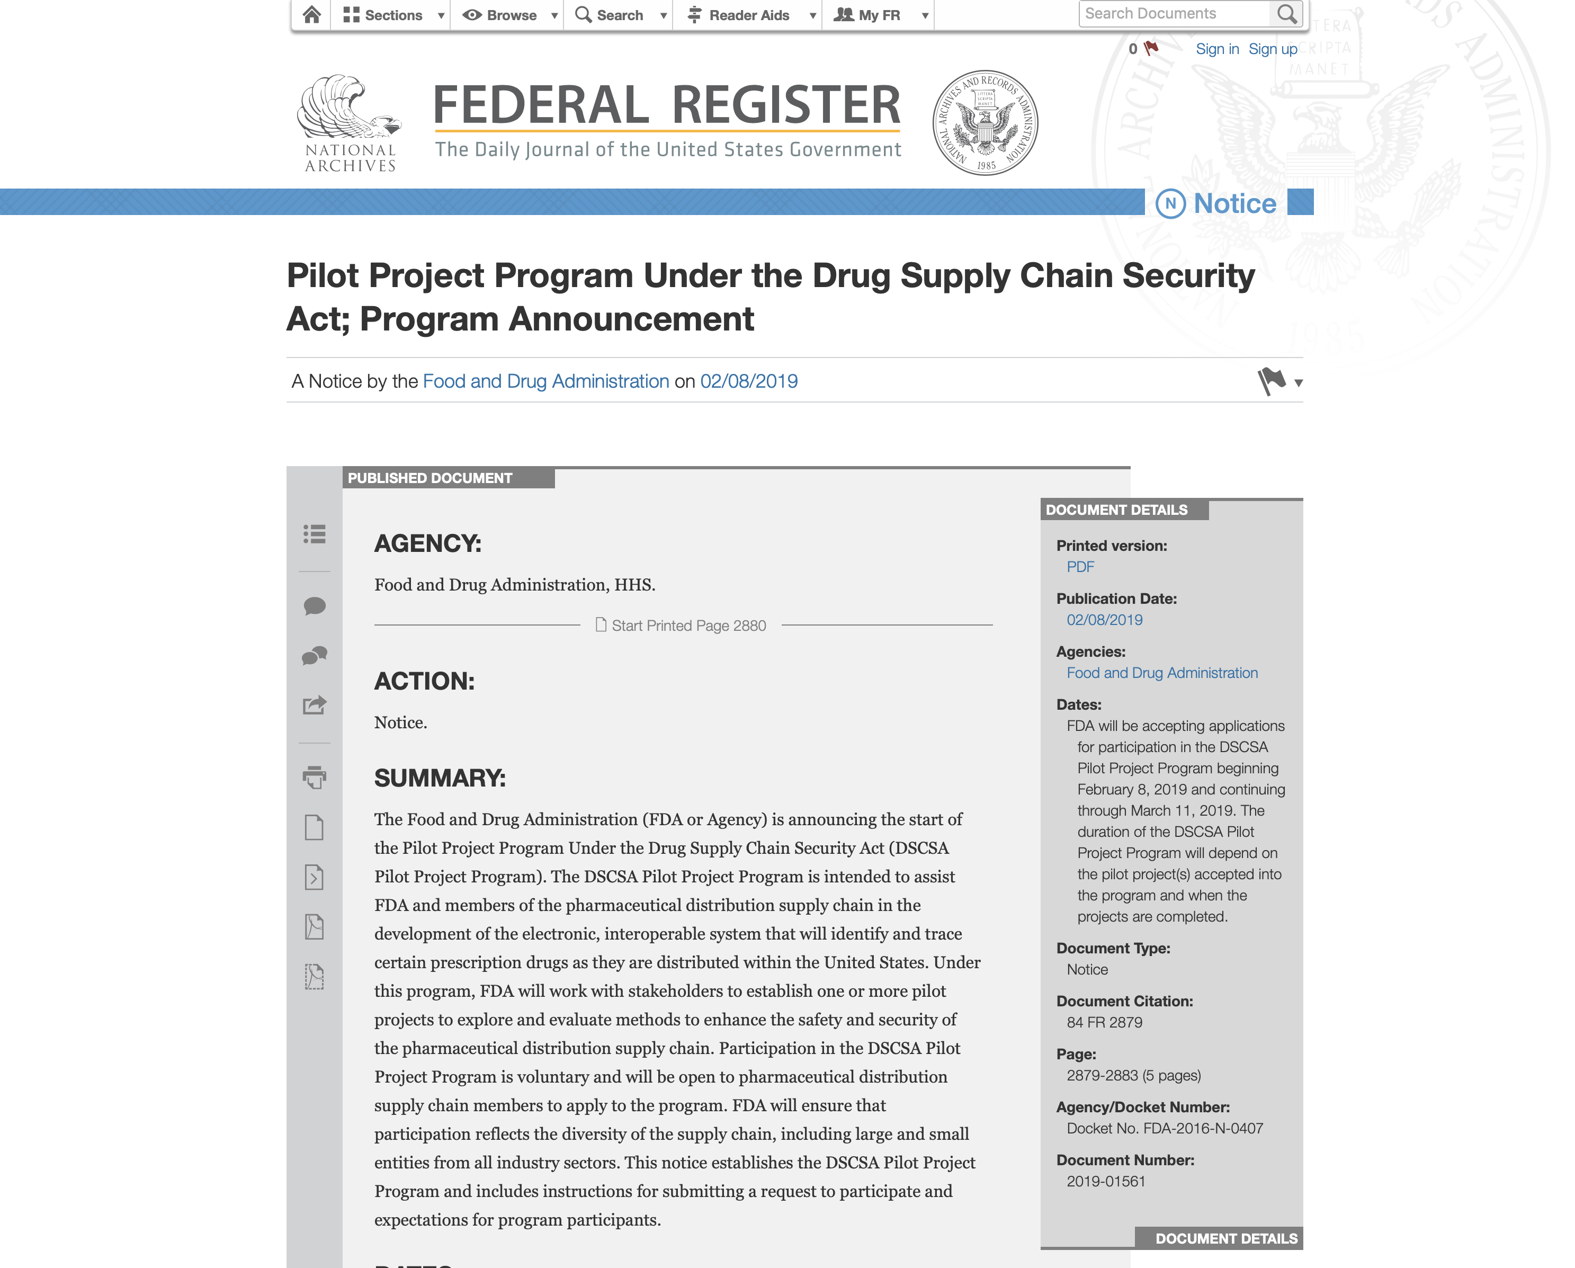
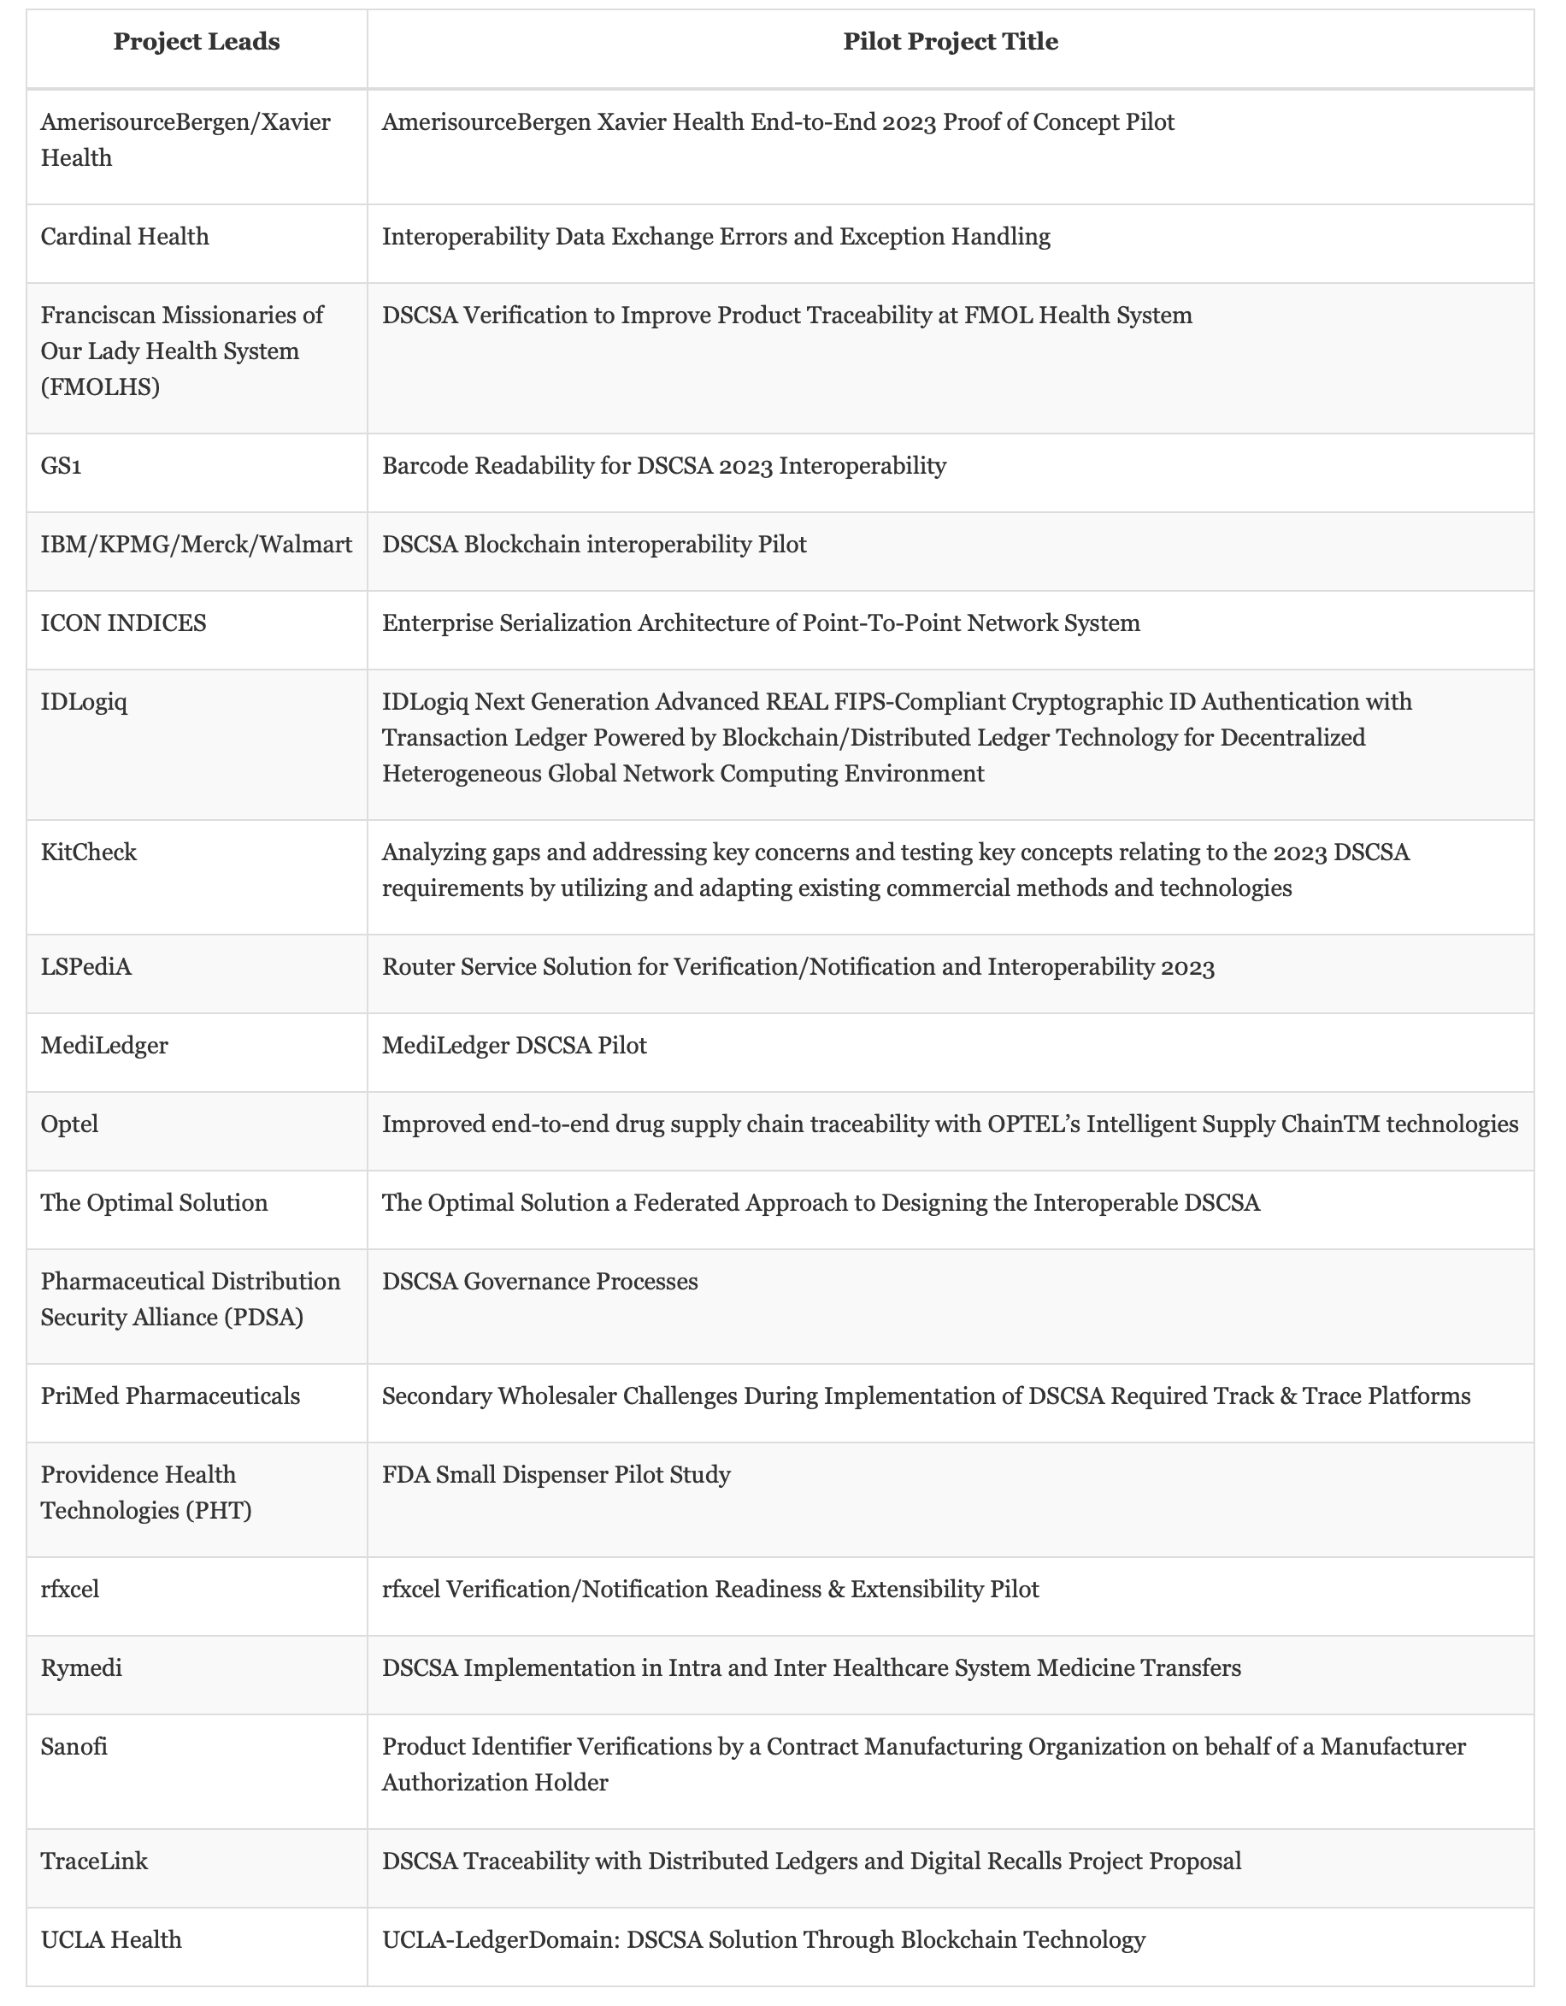
BLOCKCHAIN AND DSCSA COMPATABILITY
Key Requirements | Applicability | Compatible?
Product identification | Unique product identifier can be required contributed information validated as a side chain
Product tracing | Allows manufacturers, distributors and dispensers to provide tracing information in shared ledger
Product verification | Creates system and open solution to verify product identifier and other contributed information
Detection and response | Allows public and private actors to report and detect drugs suspected as counterfeit, unapproved, or dangerous
Notification | Creates shared system to notify FDA and other stakeholders if an illegitimate drug is found
Information requirement | Can create shared ledger of product and transaction information including verification of licensure information
Key
Yes
No

Slide 27
Assignments

Slide 28
Online Quiz
Mid-course evaluation
Online multiple choice quiz
Covers content from lectures and readings from Weeks 1-3
Can only be taken one time
Due by start of Week 4

Slide 29

Next module: Health Blockchain Stakeholders, Consortiums, and Governance

